Slide 1
How to Newrow
My Online Learning

Slide 2
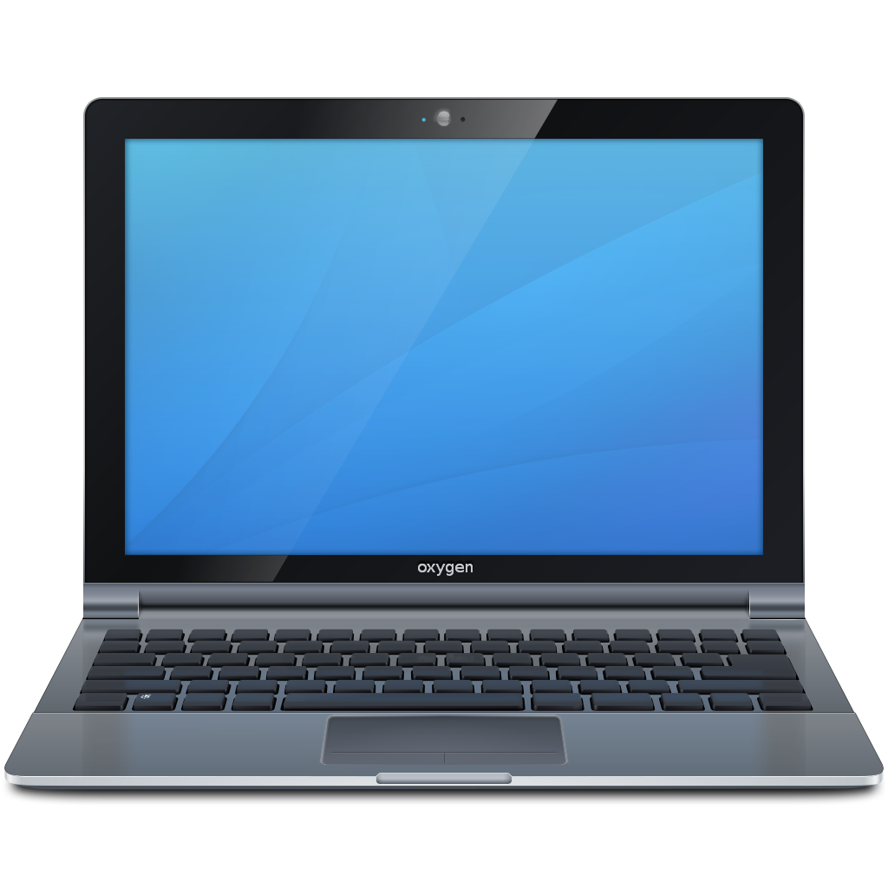
Last year most of us used Zoom to meet with our teachers and classmates. This year we will use Newrow also called Class Connect.
Class Connect
This Photo by Unknown Author is licensed under CC BY-SA
This Photo by Unknown Author is licensed under CC BY-SA

Slide 3
Once you are in

Slide 4
Once you are in your Class Connect sessions should be visible when assigned. Just click on the hyperlink.
This Photo by Unknown Author is licensed under CC BY-SA

Slide 5
Make sure that your Webcam and Microphone are checked and activated.

Slide 6
Now let’s get to know Class Connect.

Slide 7
Use these two buttons to turn the camera and microphone On/Off.

Slide 8
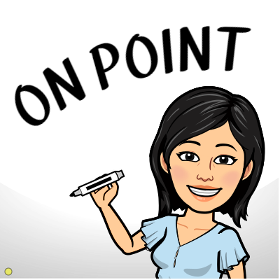
Here are your cursors
Regular cursor
High light cursor, you can use this one when showing things to your classmates.

Slide 9
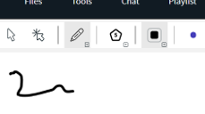
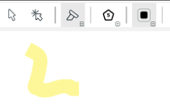
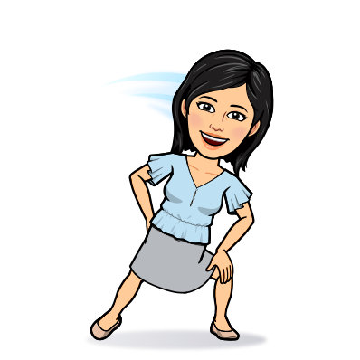
Writing/Drawing tool
Pen Highlighter Eraser Type Text

Slide 10
Use this button to make shapes and draw lines.

Slide 11
This button controls the thickness of your pen and highlighter.

Slide 12
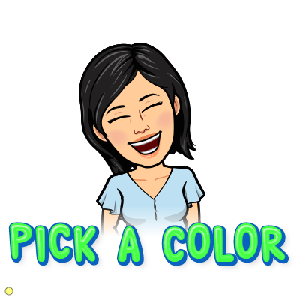
Here you can pick what color you want to use when writing, drawing, highlighting, or typing.

Slide 13
This is your chat box. Here you can communicate with the teacher and classmates (if allowed.)

Slide 14
Hope this helps, and don’t worry, we will learn this together!

